Slide 1
EduTrack
A Student Management System

Slide 2
Project Showcase
PROJECT MENTOR:
ROWZATUL ZANNAT
LECTURE
DEPT. OF CSE
DAFFODIL INTERNATIONAL UNIVERSITY
TEAM MEMBERS:
Abdullah Al Mamun Sheikh_221-15-5530
Maisha Alam_221-15-5668
Md. Merajul Alam Meraj_221-15-5632
Md. Likhon Bhuiyab_ 221-15-5966
Md. Asif Hossian_221-15-5145

Slide 3
01
02
03
Introduction
Admin Module
Teacher Module
04
05
Student Module
Future Work
Table of Contents
06
Conclusion

Slide 4
01. Introduction
4
A Student Management System (SMS) is an integrated software solution designed to manage the educational and administrative activities of educational institutions such as schools, colleges, and universities
01
This system facilitates the efficient handling of various tasks
02
Including student registration
03
Attendance tracking
04
Grade management

Slide 5
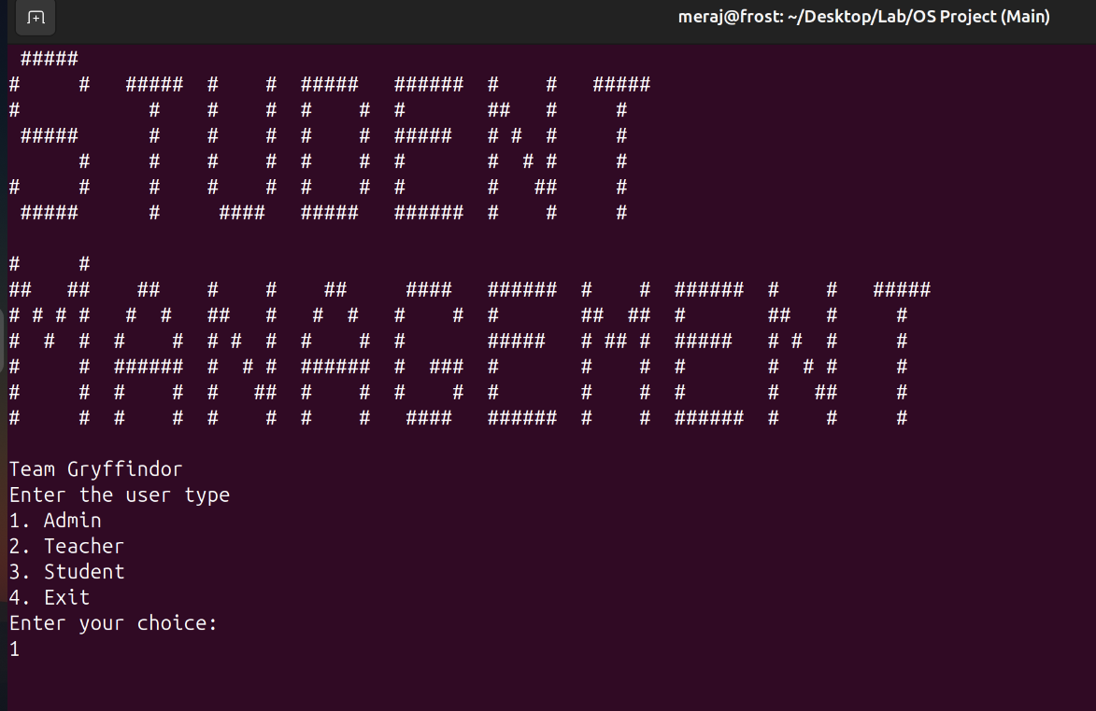
01. Introduction
5
Project Title: The project is titled "STUDENT MANAGEMENT".
Interface: The interface is text-based which runs on a Linux terminal.
User Choice: Users can select from four options: Admin, Teacher, Student, or Exit.

Slide 6
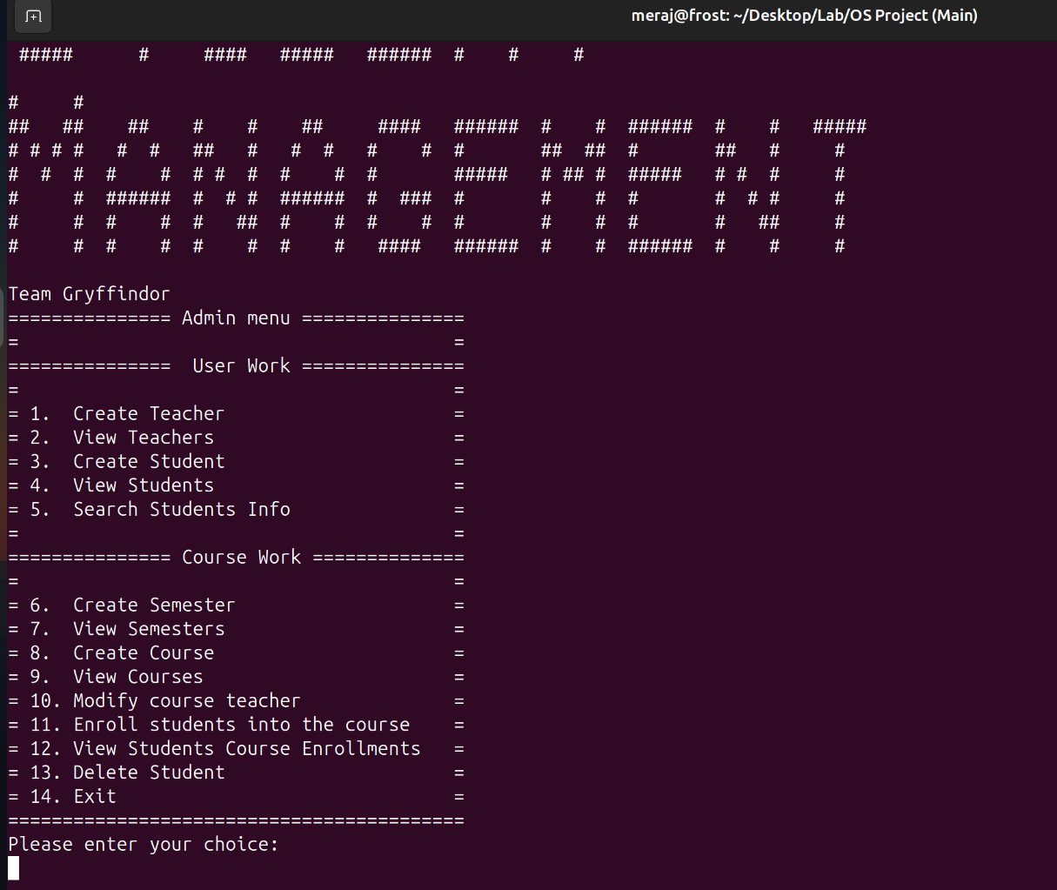
02. Admin Module
6
Admin Panel
The Admin Module is the backbone of the system. A admin can interact with other module.
Features: Create Teacher, Create Student, View Students, Create Courses, etc.
Admin's ability to manage teachers, students, courses, and semesters.

Slide 7
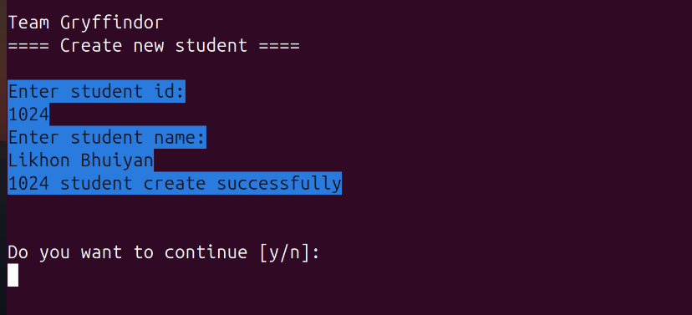
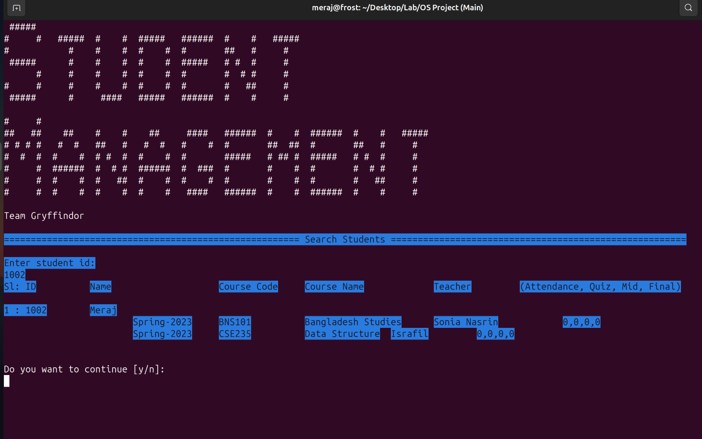
02. Admin Module
7
Create Student
Search Student

Slide 8
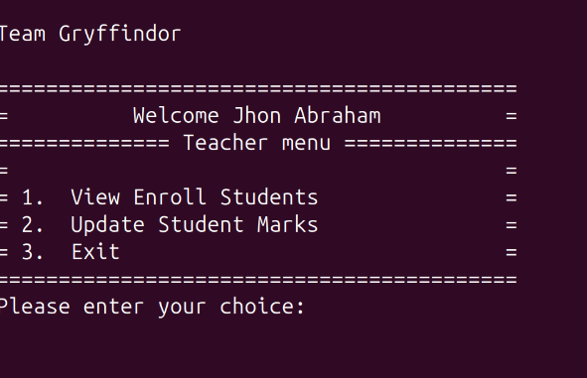
03. Teacher Module
8
Teacher Panel
The Teacher Module allows teachers to manage their students' academic data.
Features: View Enrolled Students, Update Marks, Enroll Students in Courses, etc.
Teacher's interaction with students and courses.

Slide 9
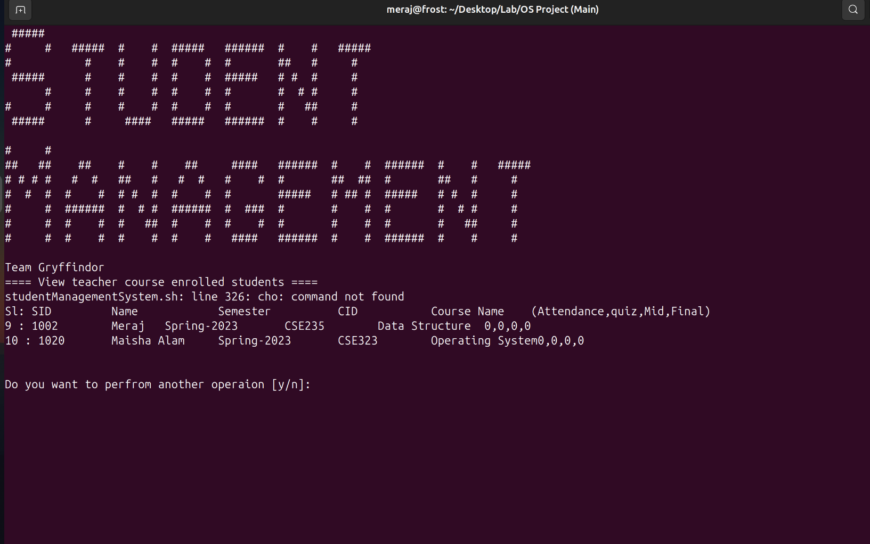
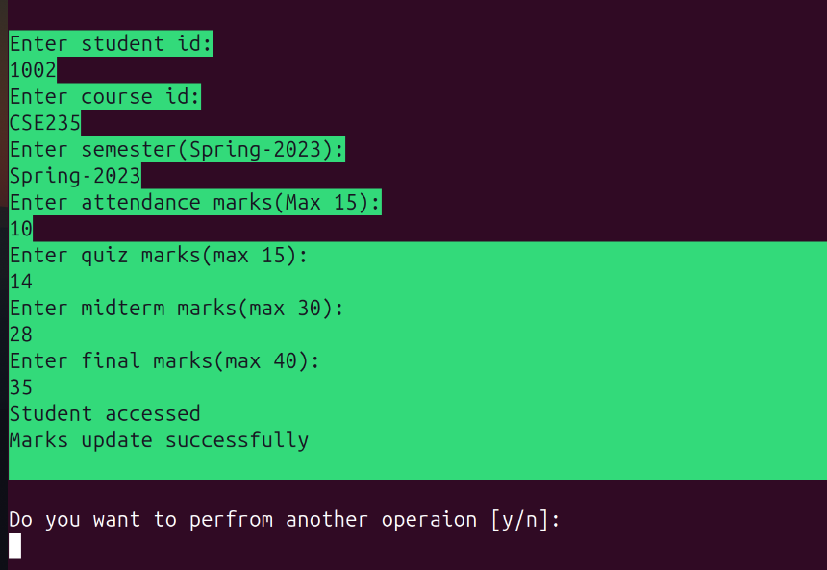
03. Teacher Module
9
View Enrolled Students
Update Student Marks

Slide 10
10
04. Student Module
The Student Module is designed for students to interact with their academic data.
View numbers and grades
View enrolled courses.
View academic semesters.

Slide 11
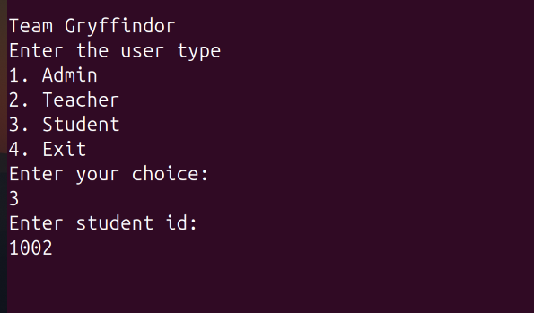
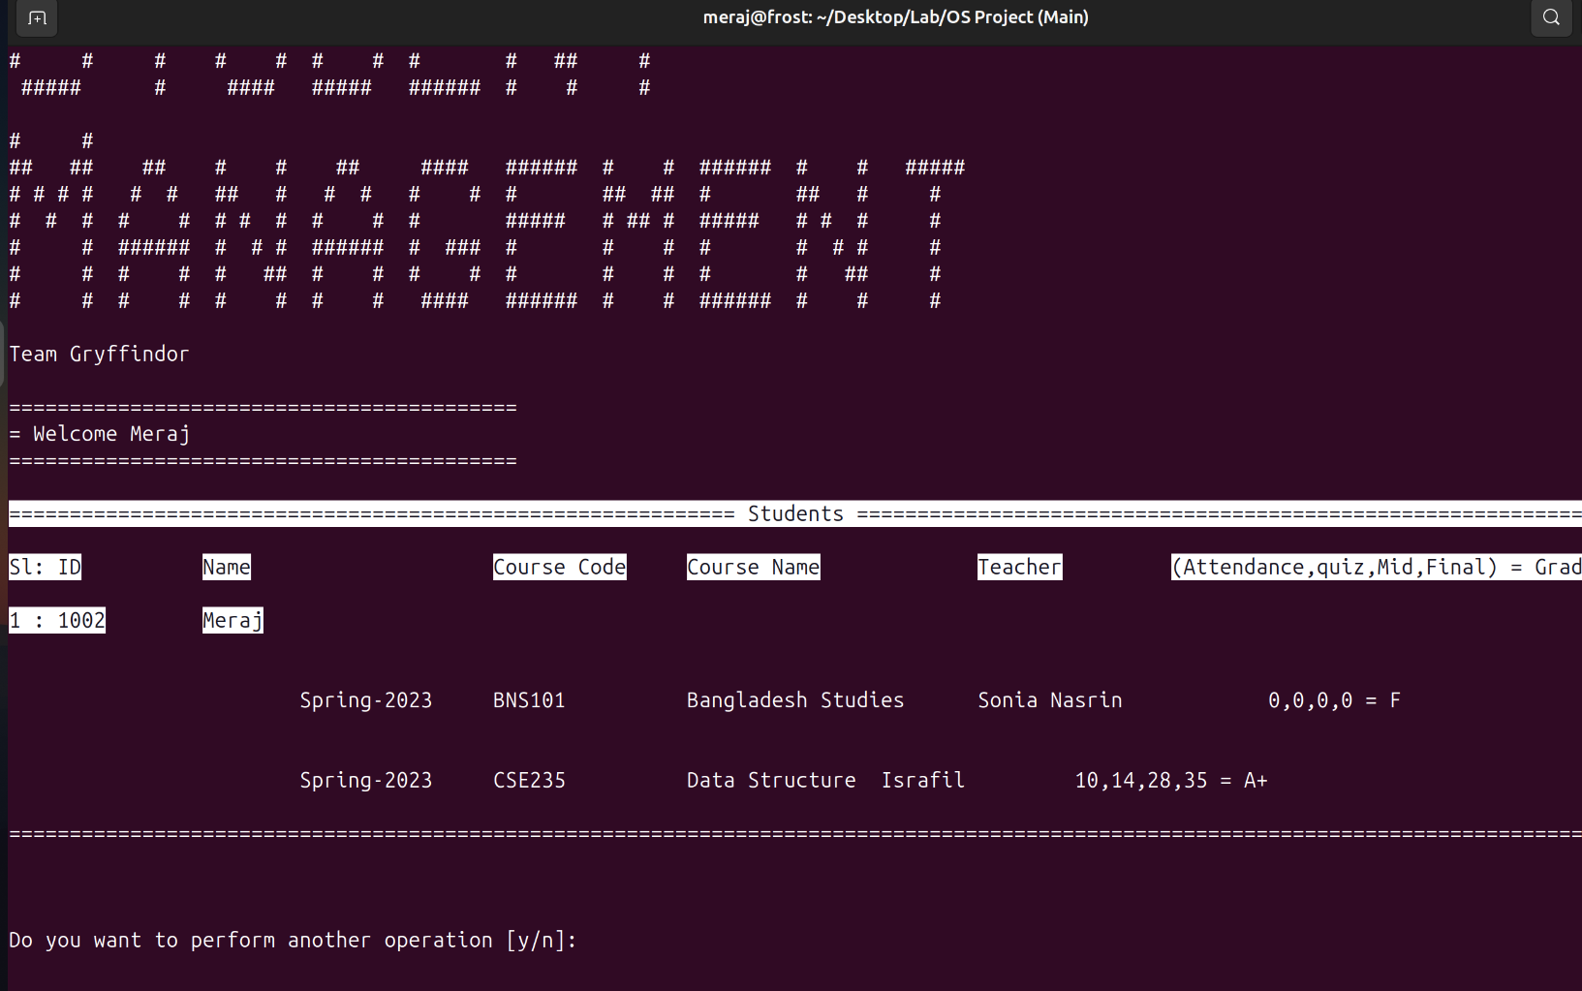
11
04. Student Module
Login
View Grades

Slide 12
05. Future Work
12
Graphical User Interface (GUI): Develop a user-friendly GUI to replace the command-line interface.
Database Integration: Transition from CSV files to a relational or NoSQL database for better scalability and performance.
Mobile Application: Create a mobile app for on-the-go access to student and teacher functionalities.
Automated Reports & Analytics: Introduce automated generation of reports for teachers and admins, providing insights into student performance.
Security Improvements: Enhance system security with password hashing, two-factor authentication, and role-based access control.

Slide 13
06. Conclusion
13
The Student Management System aims to enhance the efficiency of educational institutions by providing a user friendly platform for managing student information, improving communication between stakeholders, and streamlining academic processes.

Slide 14
Any Queries? Thank You!
Hail Gryffindor!

